Slide 1
The Nature of Information Technology Projects
Lecture 1 INFO 420 Fall 2024
Dr. Ram Arthanari
1-<number>

Slide 2
Learning Objectives
Understand why information technology (IT) projects are organizational investments..
Understand why projects are planned organizational change and why they must align with an organization’s business strategy.
Define what a project is and describe the attributes of a project.
Define the discipline called project management.
Understand the relationship among project portfolios, programs, and projects.
Understand how the disciplines of information technology and project management have evolved together and have led to how we manage projects today
Understand the current state of IT project management.
Understand why some projects fail and how to improve the likelihood of success.
1-<number>

Slide 3
Introduction
Information Technology (IT) projects are organizational investments that require
  Time
  Money
  And other resources such as people, technology, facilities, etc.
Organizations expect some type of value in return for this investment
IT projects enable the integration of technology in new products, services, or processes that can change existing relationships between an organization and its customers and suppliers as well as among the people within the organization.
1-<number>

Slide 4
The PMBOK® Guide’s Definitions for …
A project is a temporary endeavor undertaken to create a unique product, service, or result.
A project manager is the person assigned by the performing organization to achieve the project objectives.
1-<number>

Slide 5
Project Attributes
Time Frame
Purpose (to provide value!)
Ownership
Resources (the triple constraint)
Roles
  Project Manager
  Project Sponsor
  Subject Matter Expert (SME)
  Technical Expert (TE)
Risk & Assumptions
Interdependent Tasks
  progressive elaboration – steps & increments
Planned Organizational Change
Operate in Environments Larger than the Project Itself
1-<number>

Slide 6
What is Project Management?
Project Management is the application of knowledge, skills, tools and techniques to project activities to meet project requirements.
Project Portfolio – a collection of diverse projects managed collectively to align with the organization’s strategy and overall plan to achieve competitive advantage.
Program – a collection of projects within a project portfolio whose activities are coordinated so that the benefits of the program are great than the sum of the benefits of the individual projects.

Slide 7
The State of IT Project Management
The Standish Group (the CHAOS studies) and others have studied IT project success and failure.
In general, a successful project is defined as one that is completed on time, within budget, and including all of the features or requirements envisioned.
The bottom line is that, on a percentage basis, failed or challenged projects greatly exceed successful projects.
1-<number>

Slide 8
Why Many Projects Fail: Project Failure can be grouped into four categories –
  People – The stakeholders of a project with varied roles and interests in the project’s success or failure.
  Processes – This includes having a set of project management and product management processes.
  Technology – Only three percent of IT project failures can be attributed to technical challenges but this percentage can be increased if obsolete, unproven, or incompatible technologies are used.
  Organization – Organizational issues can lead to project failure. A lack of clear direction, improper strategy, rapidly changing business environment and/or customer needs can create a moving target for the product’s product or service.
1-<number>

Slide 9
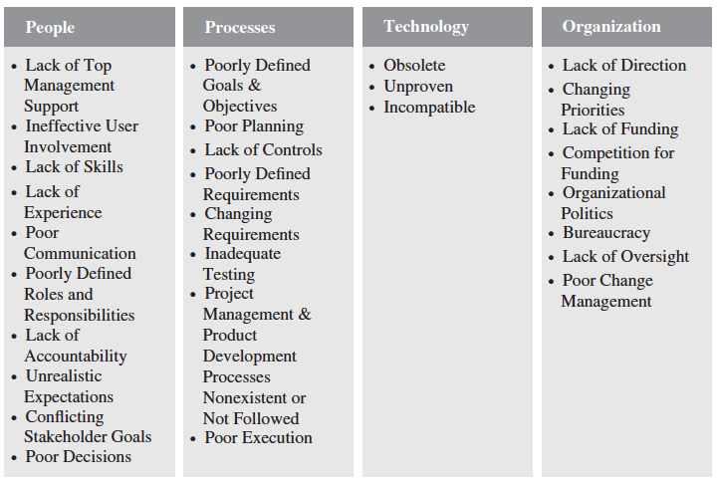
Why Many Projects Fail: Project Failure can be grouped into four categories – Examples
1-<number>

Slide 10
Improving the likelihood of success
A Value-Driven Approach
  Plain & Simple: IT Projects must provide value to the organization
Socio-technical Approach
  It’s not just about the technology or building a better mouse trap
Project Management Approach
  processes and infrastructure (Methodology)
  resources
  expectations
  competition
  efficiency and effectiveness
Knowledge Management Approach
  lessons learned, best practices & shared knowledge
1-<number>

